Slide 1
PATIENT HEALTH MONITORING SYSTEM USING LPC2129

Slide 2
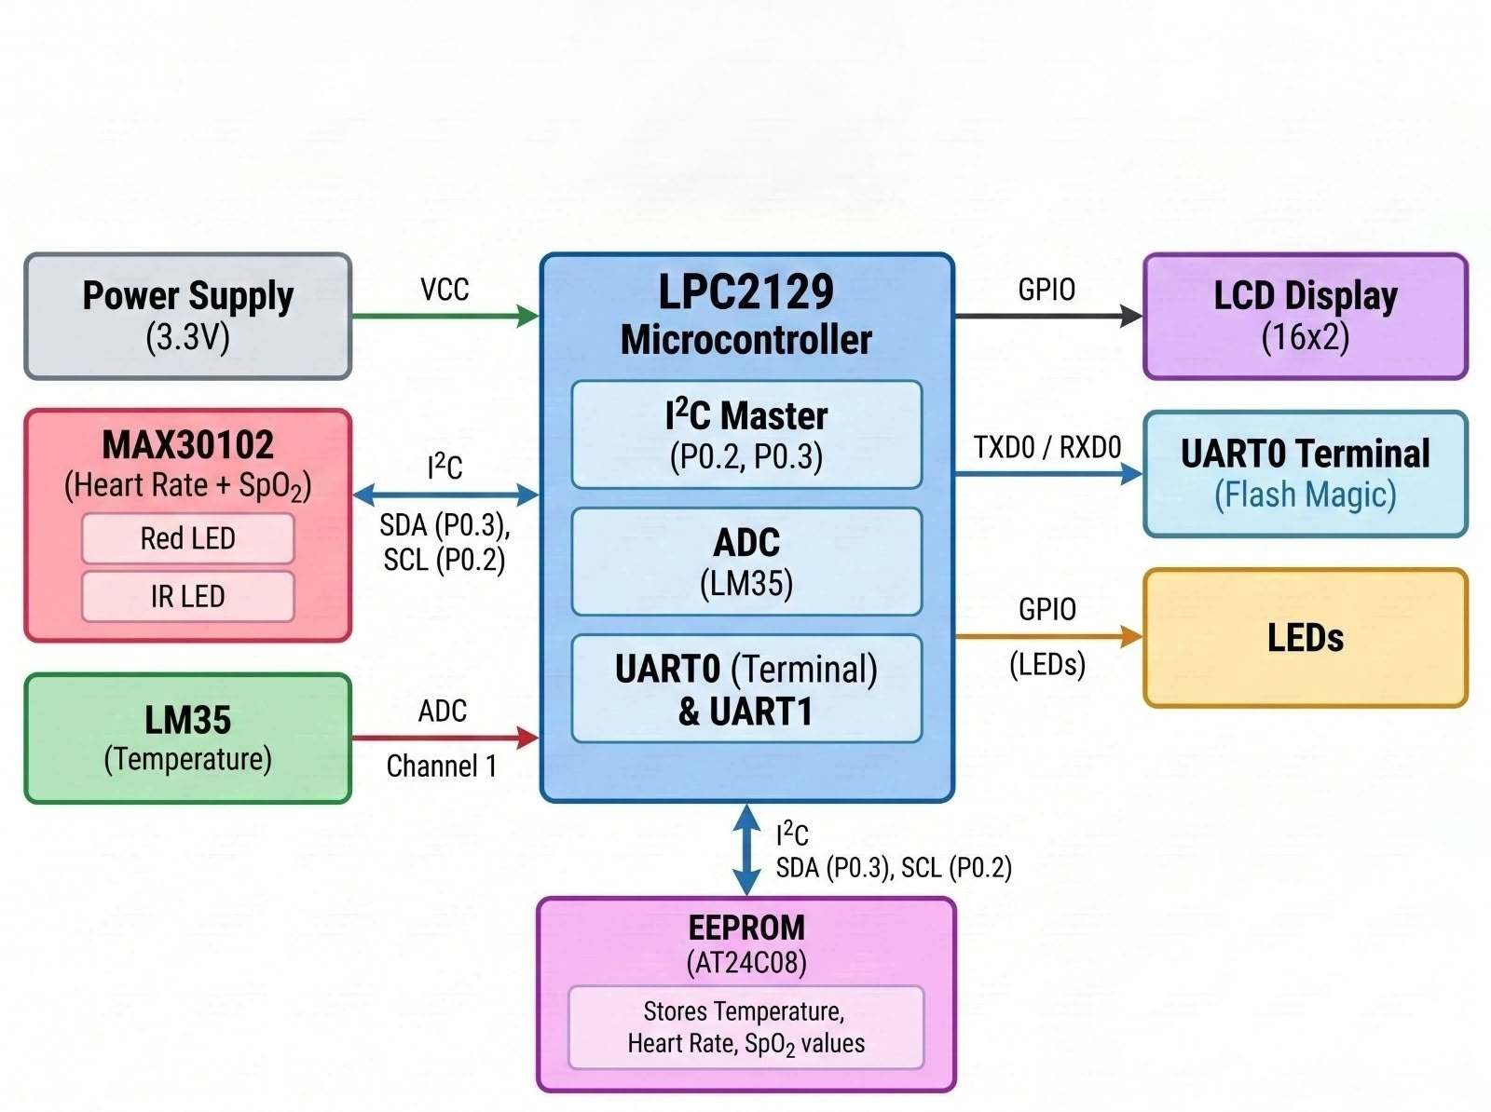
BLOCK DIAGRAM

Slide 3
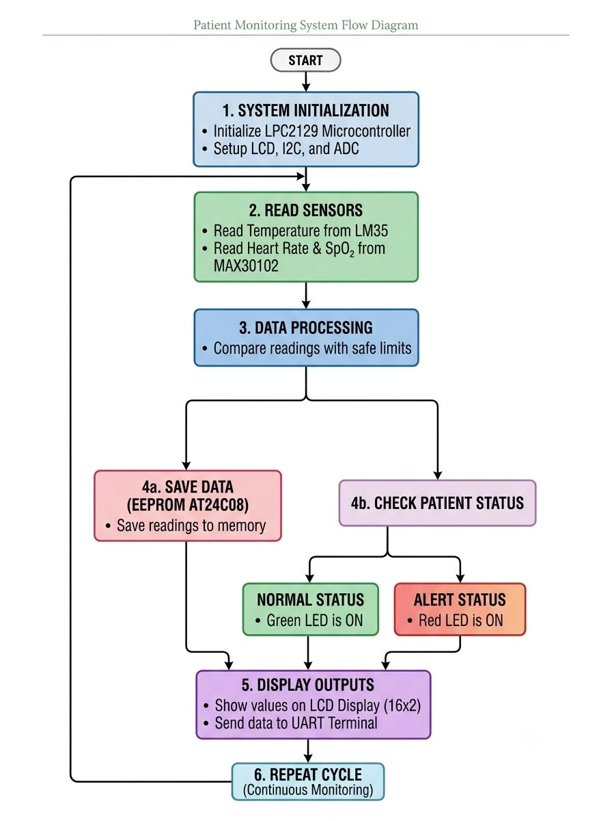
Flow Diagram

